Slide 1

DATA MANAGEMENT PROJECT
RENT PRICES IN LIEGE

Slide 2

Introduction
"The motivation behind our project is to build a model that can accurately predict student housing rent prices in the Liège region based on couple of features such as type of the accomodation and its location. Such a model can be useful for real estate agents, landlords and especially students to estimate the value of a property and make informed decisions. Moreover, the model can provide insights into the factors that influence house prices"

Slide 3

PROJECT GOALS
Scrape rental data from various sources.
Create visualizations to display model results and insights.
Develop a machine learning model to predict rent prices by zip code.

Slide 4

Data Collection
The data used in our project was sourced from two Belgian property websites, immoweb.be and kotaliege.be. These websites are popular for listing properties for sale and rental especially student housing across Belgium, including the cities of Brussels, Antwerp, Ghent, and Liège. We'll be focusing on the latter.
To scrape the data from these websites, we used Selenium, a popular web automation tool. Selenium allows us to simulate user interactions with a web page, including clicking buttons, filling out forms, and scrolling through pages. We used the Python Selenium package to write a script that navigates through the websites, extracts the type of the accommodation, prices and location and and saves it to a comma seperated values document that will allows us to navigate and deal with our data on Python.

Slide 5
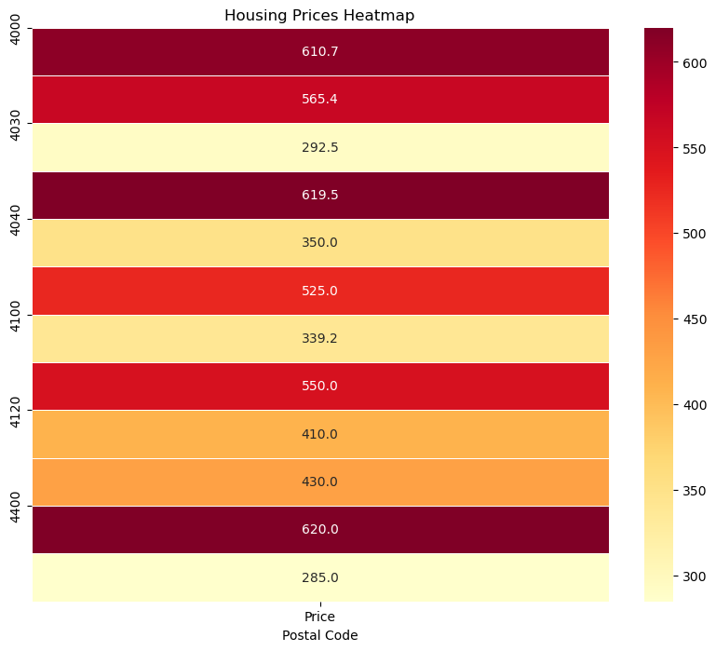
DATA VIZ
Housing prices heatmap per zip code

Slide 6
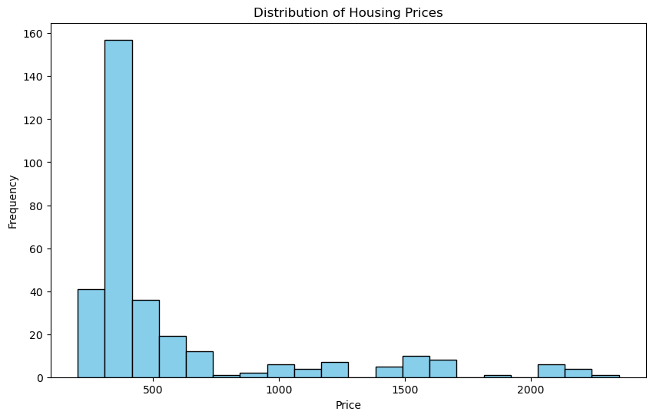
DATA VIZ
Histogramme showing the frequency of student housing rent prices in the region of Liège.
We notice that the prices that seem to be more popular in the region are between 300 and 400€ all charges included, which gives us an insight on what is considered as a fair price

Slide 7
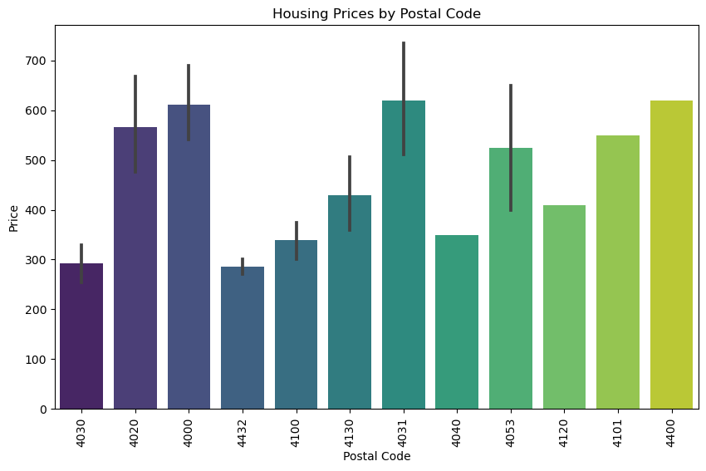
DATA VIZ
Simple bar plot showcasing the mean price per postal code while also representing the possible error of estimation in price based on postal code.

Slide 8
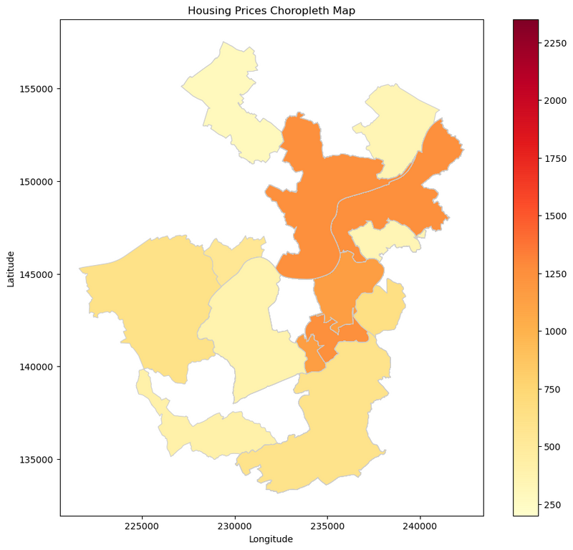
DATA VIZ
Choropleth map of the region of Liège, with the regions having the highest average prices highlighted in dark colors

Slide 9
Machine Learning Model
The prediction task in this project involves using regression to predict student housing rent prices in Liège. Regression is a supervised learning technique that aims to predict a continuous numerical value, in our case, the price of rent. The regression model is trained on a dataset of known prices gathered from the previous step and corresponding features, and then used to make predictions on the average price on each of the popular locations (zipcodes) for student housing

Slide 10
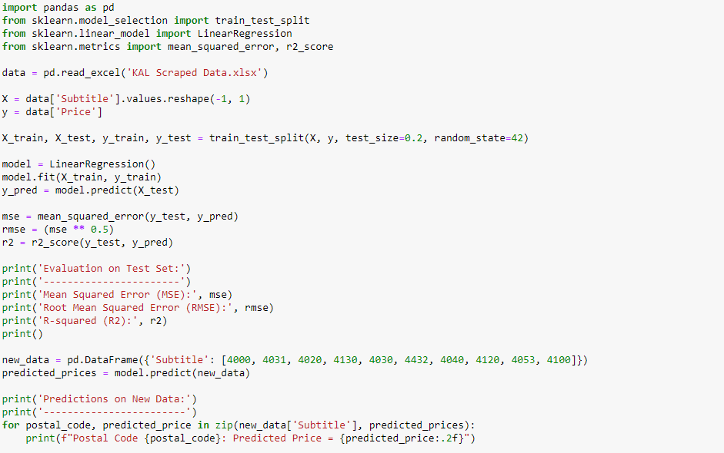
Code

Slide 11
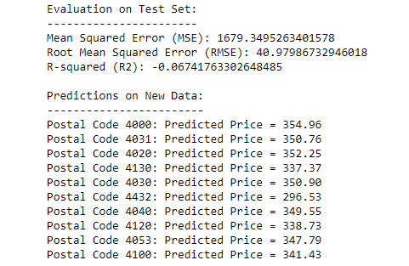
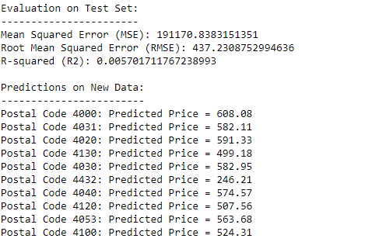
Outputs
Kotaliege only
Kotaliege + Immoweb

Slide 12
Conclusion

Slide 13

THANK YOU

